Slide 1


Title Space Can Go Here
This page is a cover example

Slide 2

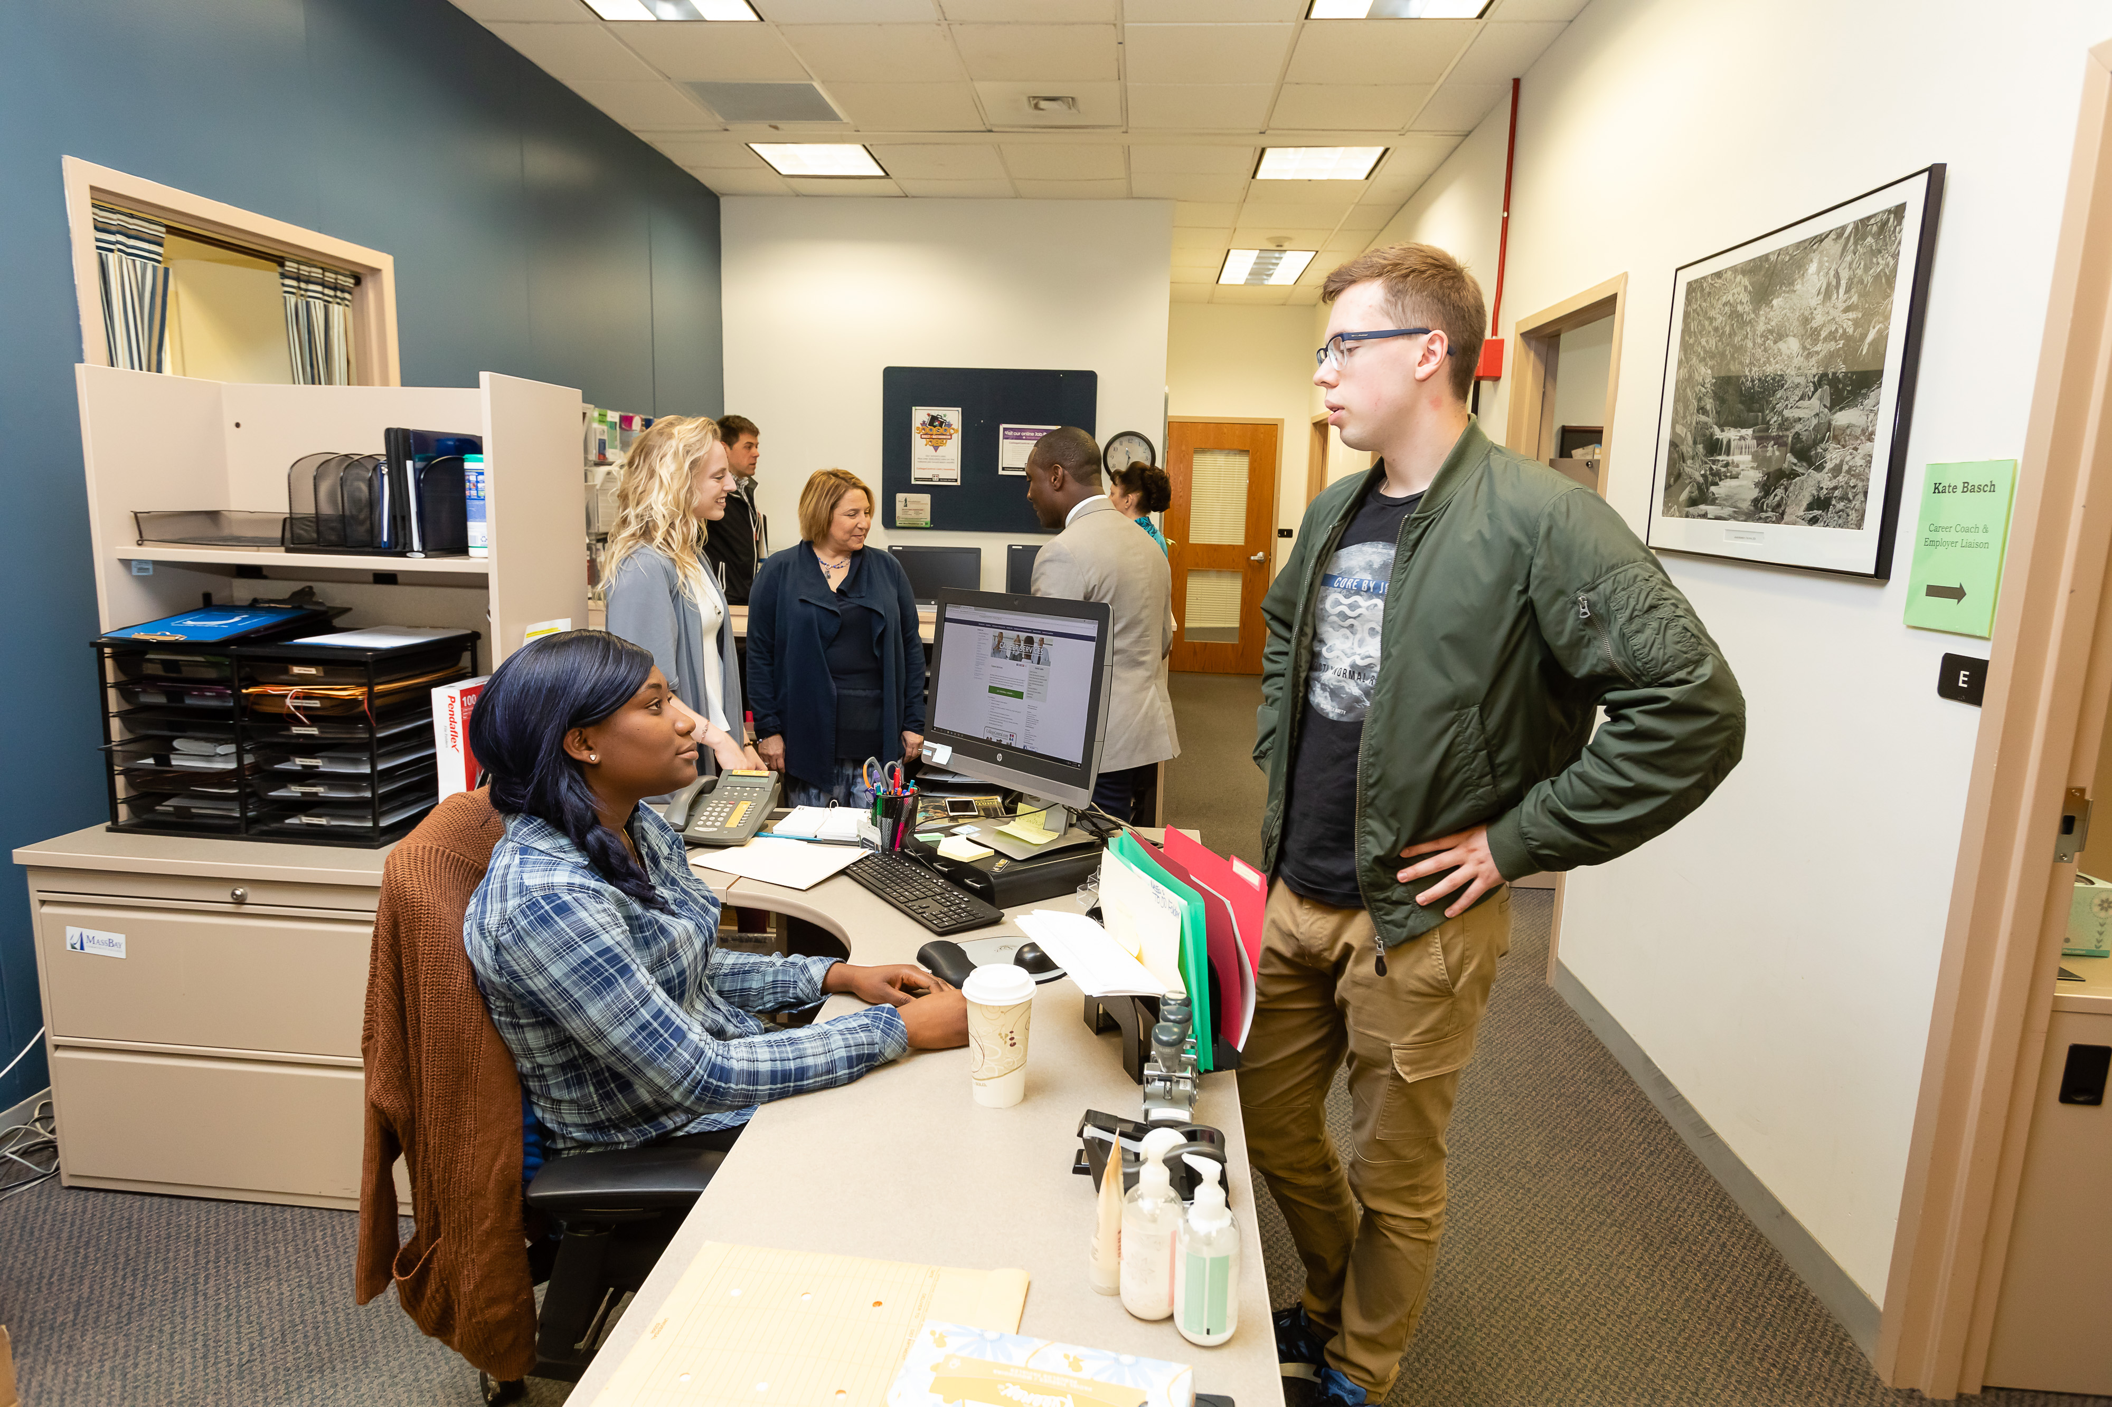
Font - Arial
Use different styles of Arial for different sections
(Bold/Black for titles, Regular for copy, or Italics for quotes).

Slide 3
Font - Arial
Use different styles of Arial for different sections
(Bold/Black for titles, Regular for copy, or Italics for quotes).
“Try playing with font size and color for emphasis. Or just for fun! ”

Slide 4
PowerPoint colors to match MassBay branding.
All of the above colors can be easily found in the type color menu or shape fill menu.

Slide 5
Logo stays in top Right
A navy blue and green color bar on the bottom of the page, or one used on the left side can bring some depth to the page and will keep the branding flowing throughout. This bar can range in size depending on if you want to use it as a design element or a functional piece that holds copy or images. See page layout examples.

Slide 6
This page can be copy and pasted and filled with your content!
Page layout example

Slide 7
Font – Arial | Header Space
Page layout example
This page can be copy and pasted and filled with your content!

Slide 8
START HERE • GO ANYWHERE
Feel free to use the MassBay slogan if it fits in your presentation or slide! You can copy and paste it from here.
Page layout example

